Slide 1
Image formation
Thanks to Peter Corke and Chuck Dyer for the use of some slides

Slide 2
Image Formation
Vision infers world properties form images.
How do images depend on these properties?
Two key elements
Geometry
Radiometry
We consider only simple models of these

Slide 3
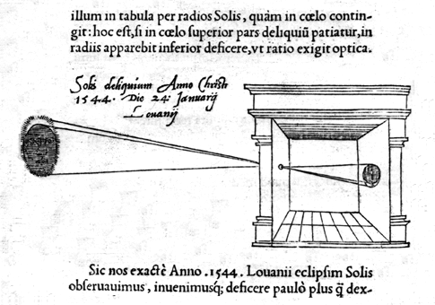
Camera Obscura
"When images of illuminated objects ... penetrate through a small hole into a very dark room ... you will see [on the opposite wall] these objects in their proper form and color, reduced in size ... in a reversed position, owing to the intersection of the rays".
Da Vinci
http://www.acmi.net.au/AIC/CAMERA_OBSCURA.html (Russell Naughton)

Slide 4
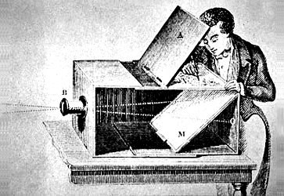
Used to observe eclipses (eg., Bacon, 1214-1294)
By artists (eg., Vermeer).

Slide 5
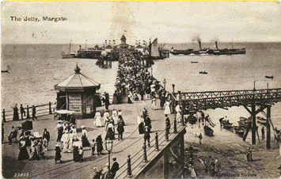
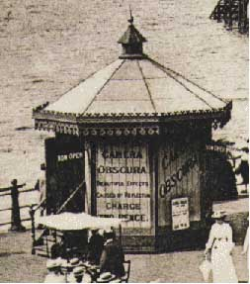
Jetty at Margate England, 1898.
http://brightbytes.com/cosite/collection2.html (Jack and Beverly Wilgus)

Slide 6
Cameras
First photograph due to Niepce
First on record shown in the book - 1822

Slide 7
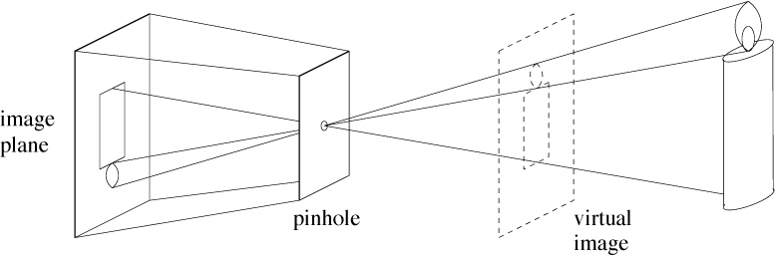
Pinhole cameras
Abstract camera model - box with a small hole in it
Pinhole cameras work in practice
(Forsyth & Ponce)

Slide 8
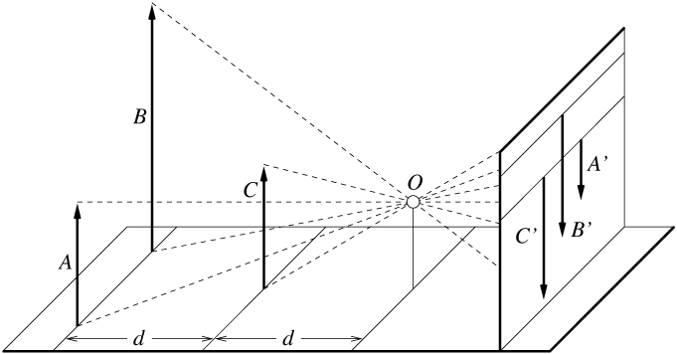
Distant objects are smaller
(Forsyth & Ponce)

Slide 9
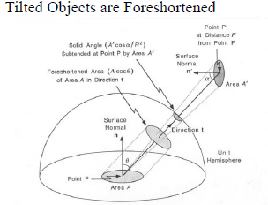

Slide 10
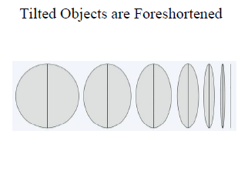

Slide 11
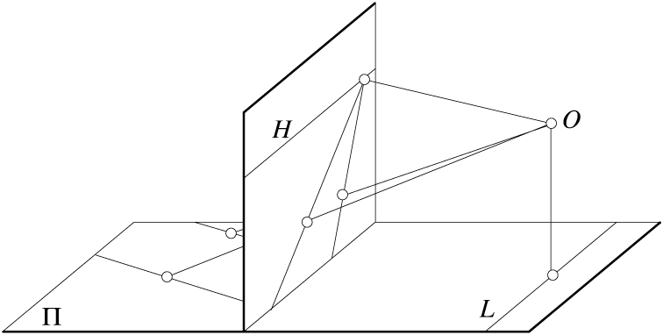
Parallel lines meet
Common to draw image plane in front of the focal point. Moving the image plane merely scales the image.
(Forsyth & Ponce)

Slide 12
Vanishing points
Each set of parallel lines meets at a different point
The vanishing point for this direction
Sets of parallel lines on the same plane lead to collinear vanishing points.
The line is called the horizon for that plane

Slide 13
Properties of Projection
Points project to points
Lines project to lines
Planes project to the whole image or a half image
Angles are not preserved
Degenerate cases
Line through focal point projects to a point.
Plane through focal point projects to line
Plane perpendicular to image plane projects to part of the image (with horizon).

Slide 14
Take out paper and pencil

Slide 15
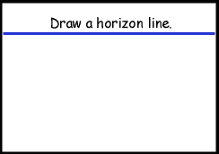
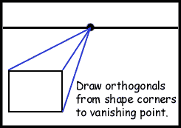
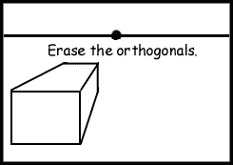
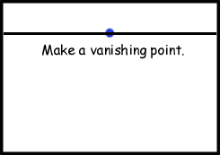
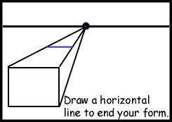
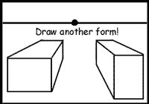
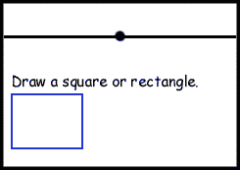
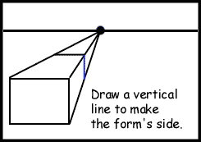
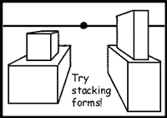
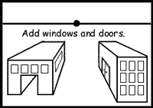

Slide 16
http://www.sanford-artedventures.com/create/tech_1pt_perspective.html

Slide 17
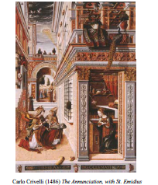

Slide 18
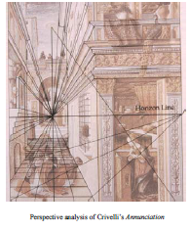

Slide 19
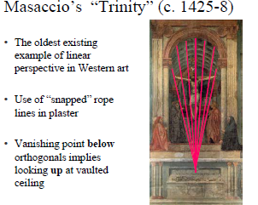

Slide 20
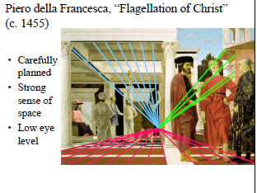

Slide 21
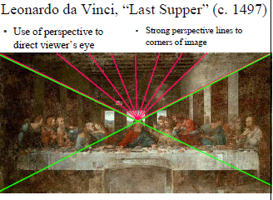

Slide 22
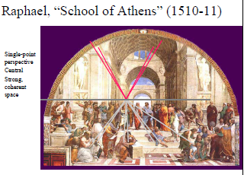

Slide 23
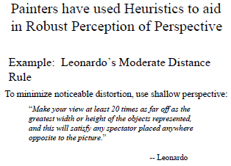

Slide 24
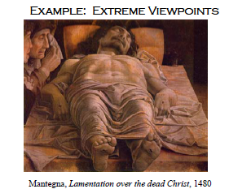

Slide 25
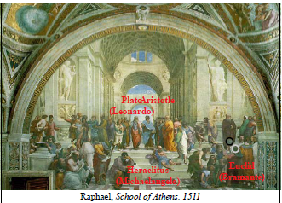

Slide 26
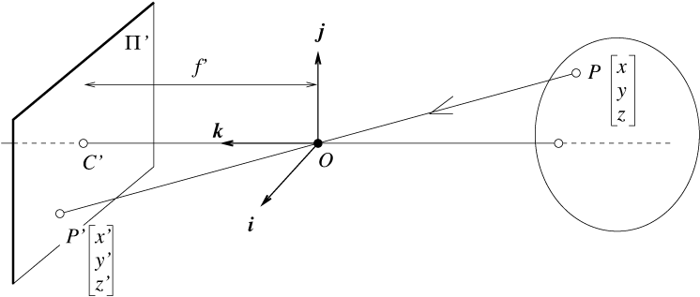
The equation of projection
(Forsyth & Ponce)

Slide 27
The equation of projection
Cartesian coordinates:
We have, by similar triangles, that
Ignore the third coordinate, and get

Slide 28
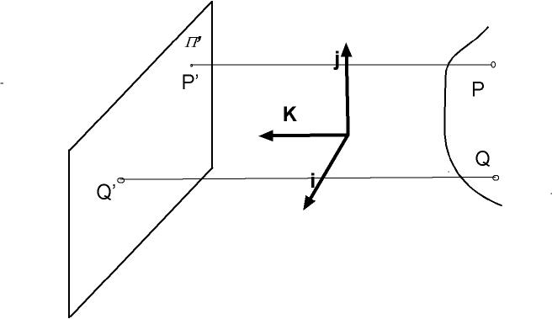
Orthographic projection

Slide 29
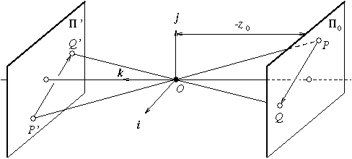
Weak perspective (scaled orthographic projection)
Issue
perspective effects, but not over the scale of individual objects
collect points into a group at about the same depth, then divide each point by the depth of its group
(Forsyth & Ponce)

Slide 30
The Equation of Weak Perspective
s is constant for all points.
Parallel lines no longer converge, they remain parallel.

Slide 31
Pros and Cons of These Models
Weak perspective much simpler math.
Accurate when object is small and distant.
Most useful for recognition.
Pinhole perspective much more accurate for scenes.
Used in structure from motion.
When accuracy really matters, must model real cameras.

Slide 32
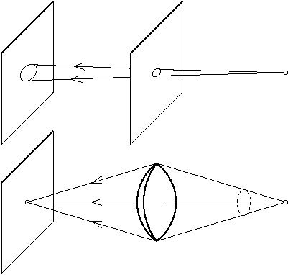
Cameras with Lenses
(Forsyth & Ponce)

Slide 33
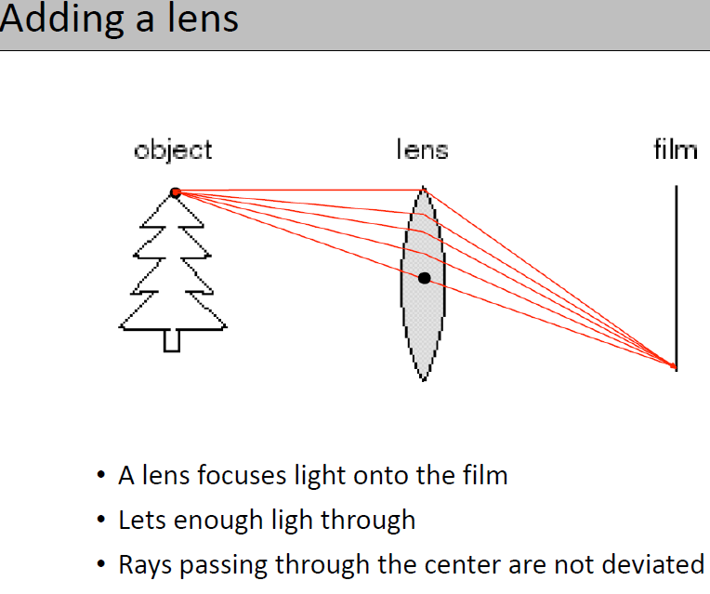

Slide 34
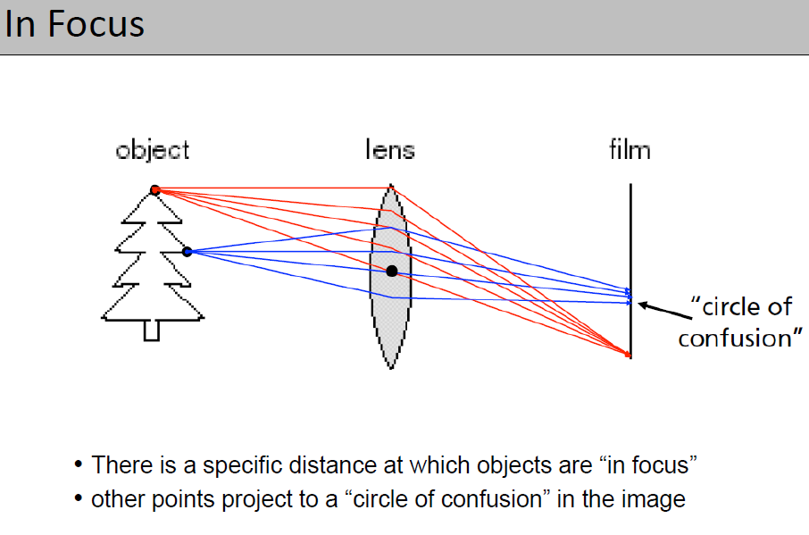

Slide 35
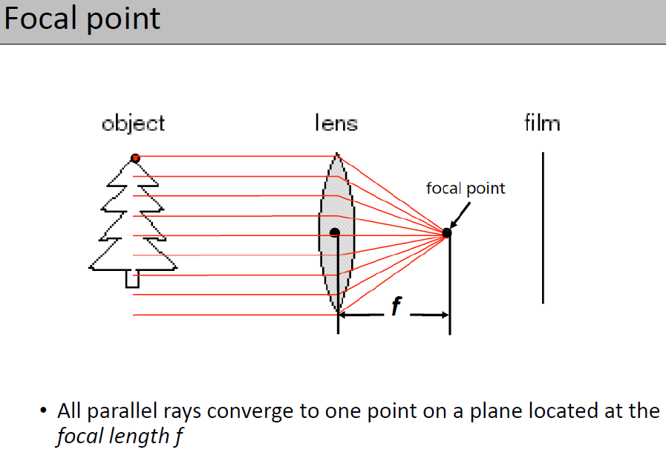

Slide 36
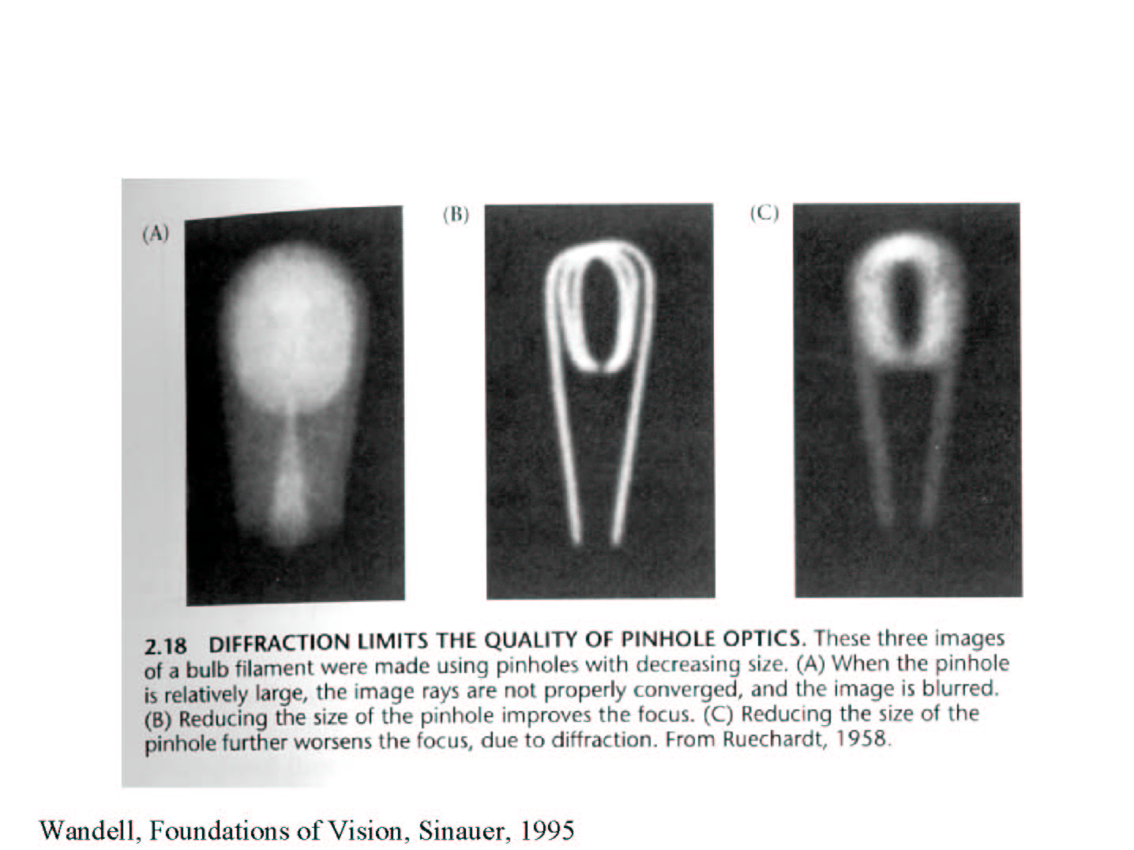

Slide 37
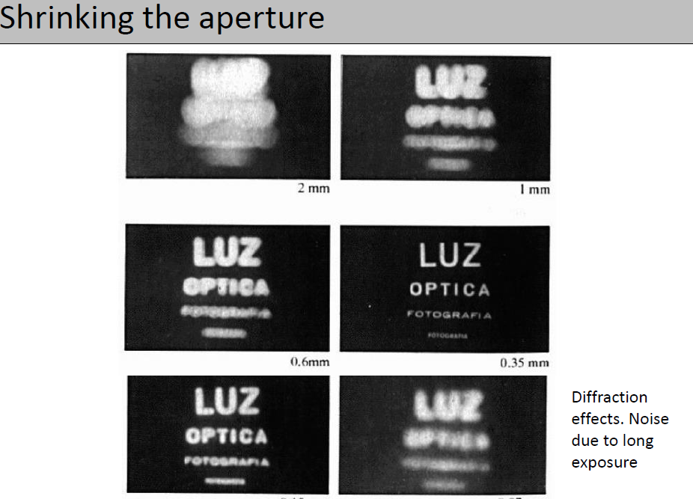

Slide 38
Interaction of light with matter
Absorption
Scattering
Refraction
Reflection
Other effects:
Diffraction: deviation of straight propagation in the presence of obstacles
Fluorescence:absorbtion of light of a given wavelength by a fluorescent molecule causes reemission at another wavelength

Slide 39
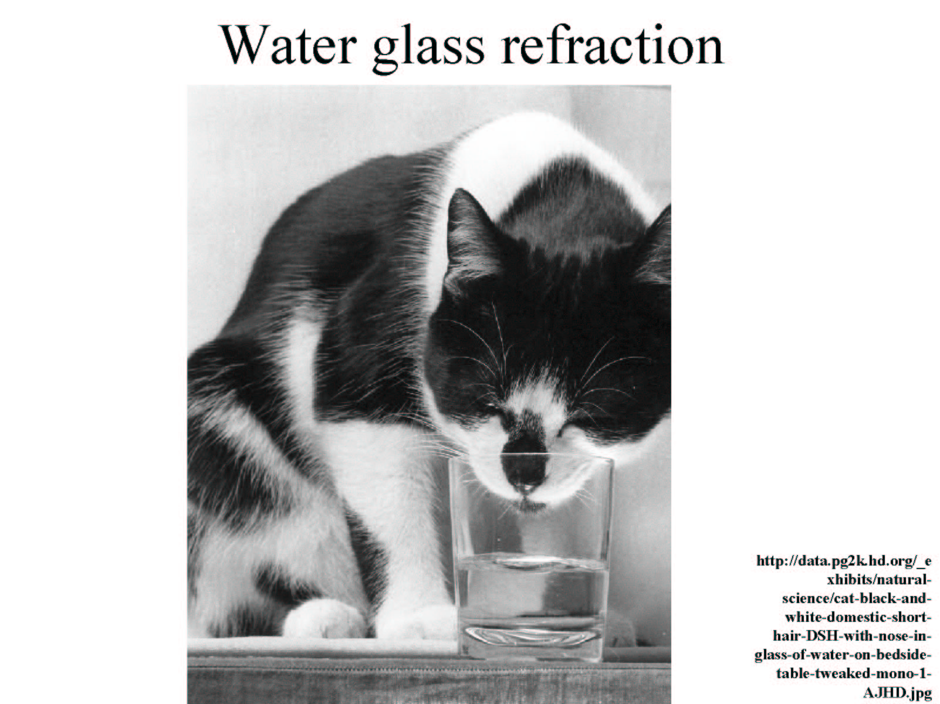

Slide 40
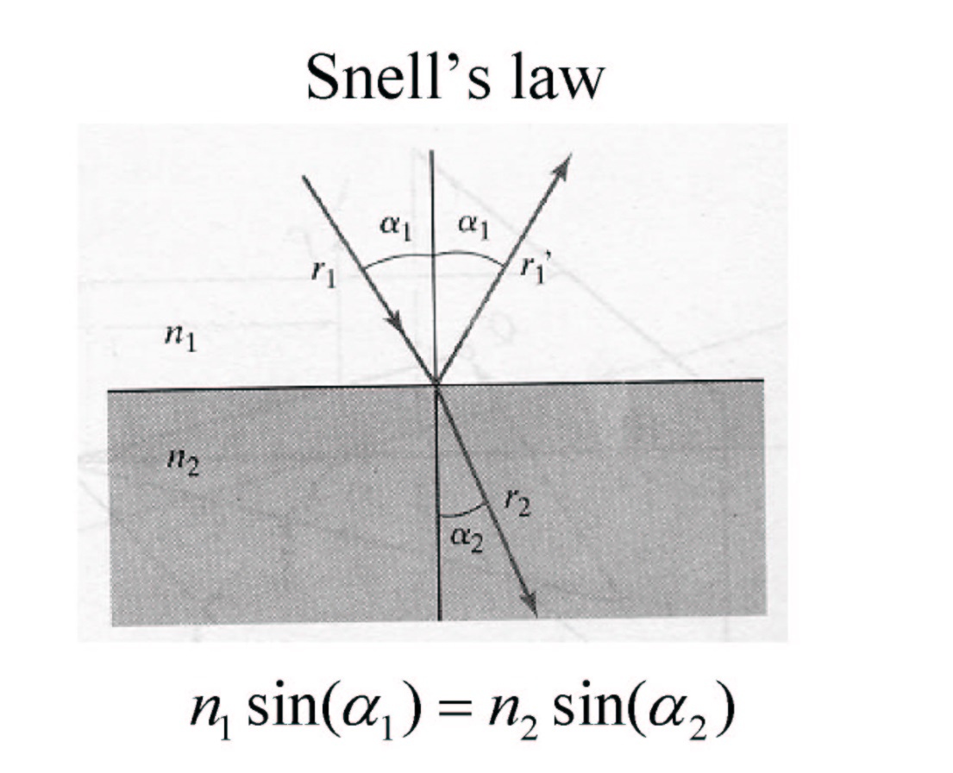
Refraction
n1, n2: indexes of refraction

Slide 41
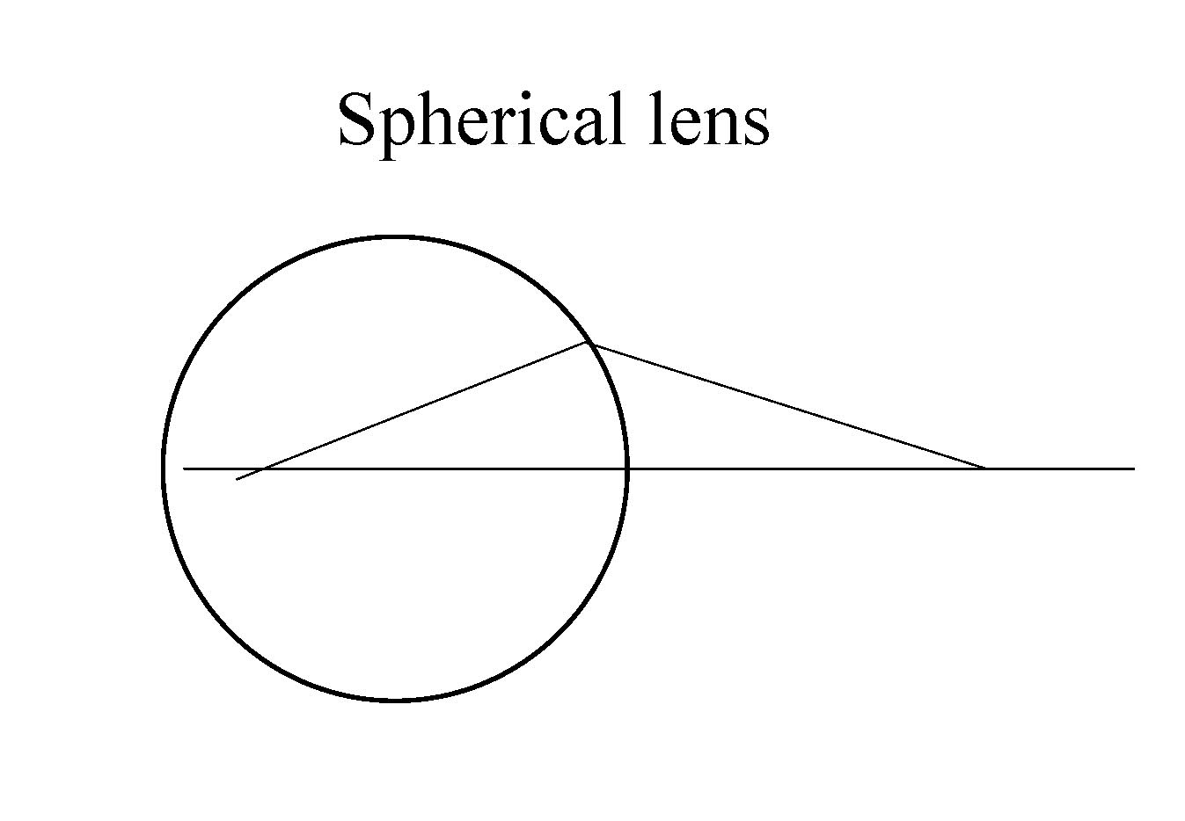

Slide 42
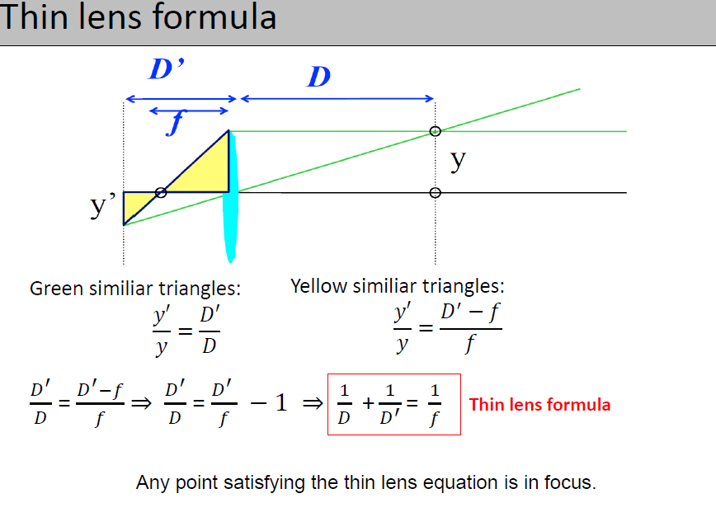

Slide 43
Assumptions for thin lens equation
Lens surfaces are spherical
Incoming light rays make a small angle with the optical axis
The lens thickness is small compared to the radii of curvature
The refractive index is the same for the media on both sides of the lens

Slide 44
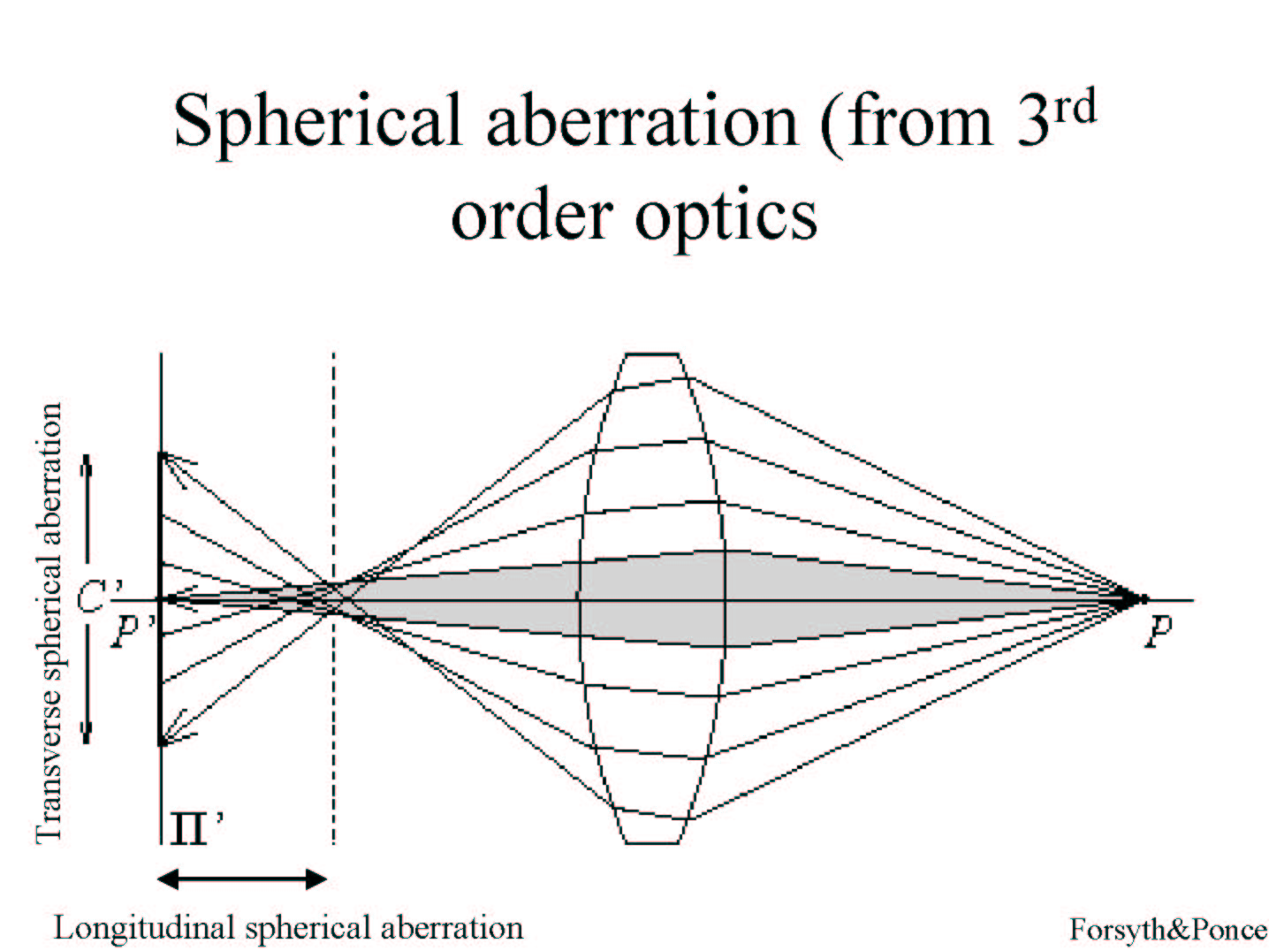

Slide 45
Other aberrations
Astigmatism: unevenness of the cornea
Distortion : different areas of lens have different focal length
Coma : point not on optical axis is depicted as asymmetrical comet-shaped blob
Chromatic aberration

Slide 46
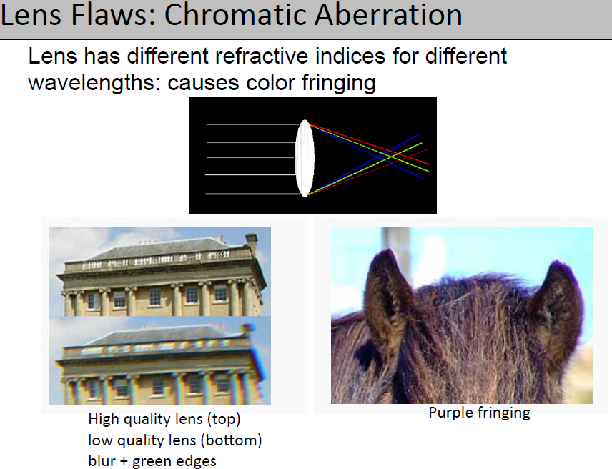

Slide 47
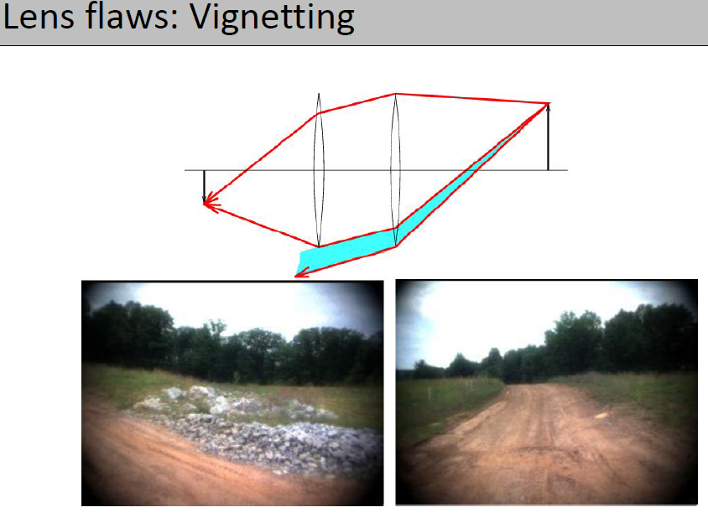

Slide 48
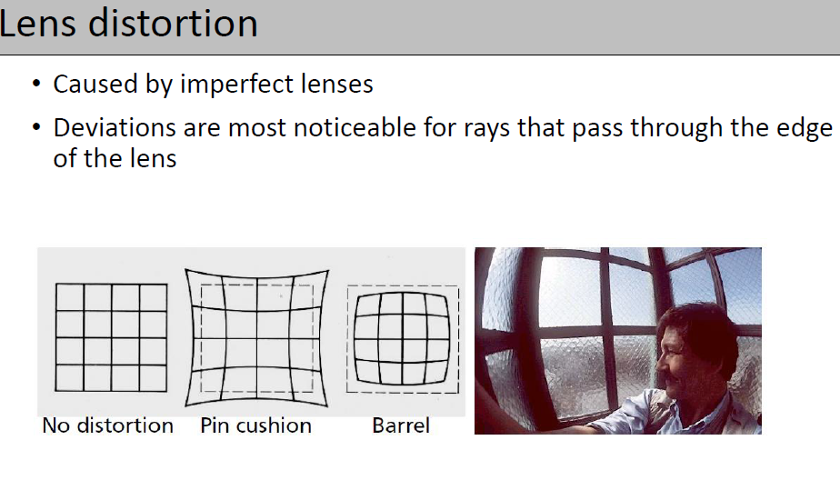

Slide 49
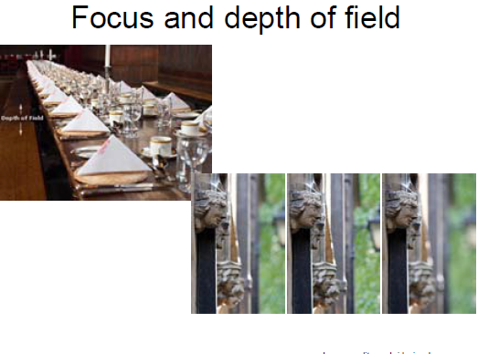

Slide 50
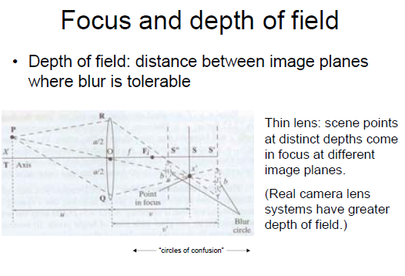

Slide 51
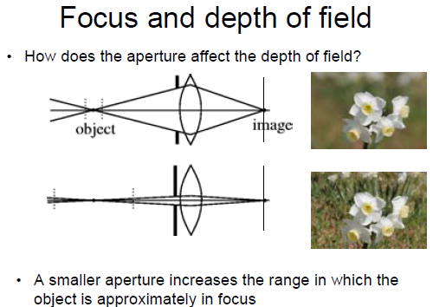

Slide 52
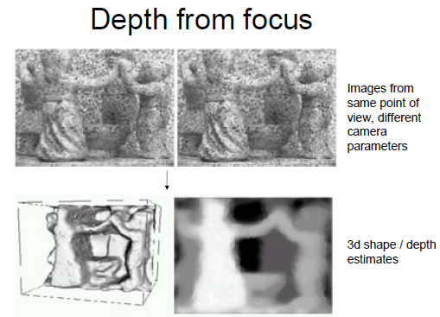

Slide 53
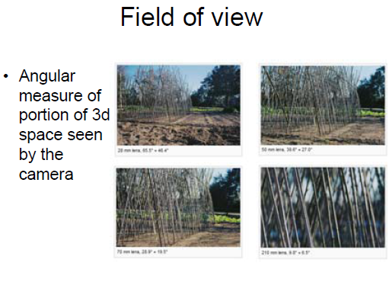

Slide 54


Slide 55


Slide 56


Slide 57


Slide 58

Summary

Slide 59


Slide 60
Non perspective models

Slide 61



Fish-eye lens camera

Slide 62

Different models

Slide 63

Catadioptric sensors

Slide 64

Catadioptric sensor and its image

Slide 65

Catadioptric geometry

Slide 66

Spherical Eye

Slide 67



Spherical Eye equations

Slide 68

Unified imaging

Slide 69

Unified imaging

Slide 70
Back to equations

Slide 71



Slide 72


Slide 73


Slide 74


Slide 75


Slide 76


Slide 77


Slide 78


Slide 79


Slide 80


Slide 81
Properties of P: the projective camera
P is a general 3X4 matrix of rank 3. If it has rank less than 3 then the projection is line or point, not the whole plane.
C is the camera center if and only if PC=0. Indeed, if PC=0, consider the line containing C and any point A in 3-space. Points on this line are: X(k)=kA+(1-k)C. Mapping any such point with P we get: PX=kPA. All points on the line map to PA.

Slide 82

The rows and columns of P
P = $\begin{matrix}p_{11} & p_{12} & p_{13} \\ p_{21} & p_{22} & p_{23} \\ p_{31} & p_{32} & p_{33}\end{matrix} \begin{matrix}p_{14} \\ p_{24} \\ p_{34}\end{matrix}$
P = $\begin{matrix}p^{1T} \\ p^{2T} \\ p^{3T}\end{matrix}$ P= $p_{1}$ $p_{2 }p_{3 }p_{4}$

Slide 83

Columns=image points, rows=world planes
The first three columns are the vanishing points of the world axes X,Y,Z; X axis has direction D=(1,0,0,0) and PD=p1, etc. The last column is the image of the world origin.
The rows represent planes:
The principal plane (through camera center parallel to the image): If X lies on this plane then PX=(x,y,0), or $p^{3T}$X=0.
Consider points X on plane $p^{1T}$ . Then $p^{1T}$X =0, so PX=(0,y,w), the points on the image x-axis. Since also $p^{1T}$C=0, plane $p^{1T}$ passes from the camera center and the y image axis. Similarly for the second plane.

Slide 84



Measurements on planes
4
3
2
1
1
2
3
4
Approach: unwarp then measure
What kind of warp is this?
Notes:
homography!

Slide 85
Image rectification
p’
p
To unwarp (rectify) an image
solve for homography H given p and p’
solve equations of the form: wp’ = Hp
linear in unknowns: w and coefficients of H
H is defined up to an arbitrary scale factor
how many points are necessary to solve for H?

Slide 86




Solving for homographies

Slide 87


Solving for homographies
A
h
0
2n × 9
9
2n
Linear least squares
Since h is only defined up to scale, solve for unit vector ĥ
Minimize
Solution: ĥ = eigenvector of A^{T}A with smallest eigenvalue
Works with 4 or more points

